Slide 1
Larry Cardman’s Contributions to Polarized Electron Sources and Accelerator Physics at JLab
Charlie Sinclair

Slide 2
A brief history
When I joined CEBAF in September ‘87, developing a polarized source for the lab was one of my jobs. I outlined the possibilities in an October 30 memo.
A polarized source was NOT included within the CEBAF “scope” at that time!
In mid-December, I received a call from Larry telling me he was submitting a proposal to NSF to develop a polarized source for CEBAF

Slide 3
Larry’s initial NSF source proposal
Improvements to the helium chemi-ionization source
Design a system to capture and bunch a large fraction of a DC beam
Begin an accelerator physics program at Illinois, centered on their proposed microtron
Incorporate the source in their microtron, or failing that, at CEBAF

Slide 4
All this led to…………..
A great collaboration
Four Illinois students completing Ph.D. research in accelerator physics at CEBAF
Construction of the first GaAs source, spin manipulator, and Mott polarimeter for CEBAF
Significant improvements to the helium source (by Walters and Dunning at Rice U.)
Early photoemission electron source developments that have led to much important subsequent work

Slide 5
Four fine Ph.D. students
Bruce Dunham – the first polarized source for CEBAF
Nick Sereno – beam recirculation studies in the CEBAF front end
Dave Engwall – 500 kV photoemission gun, ultimately used in the first injector for the IRFEL
Joe Grames – precision studies of spin transport through the full CEBAF machine

Slide 6
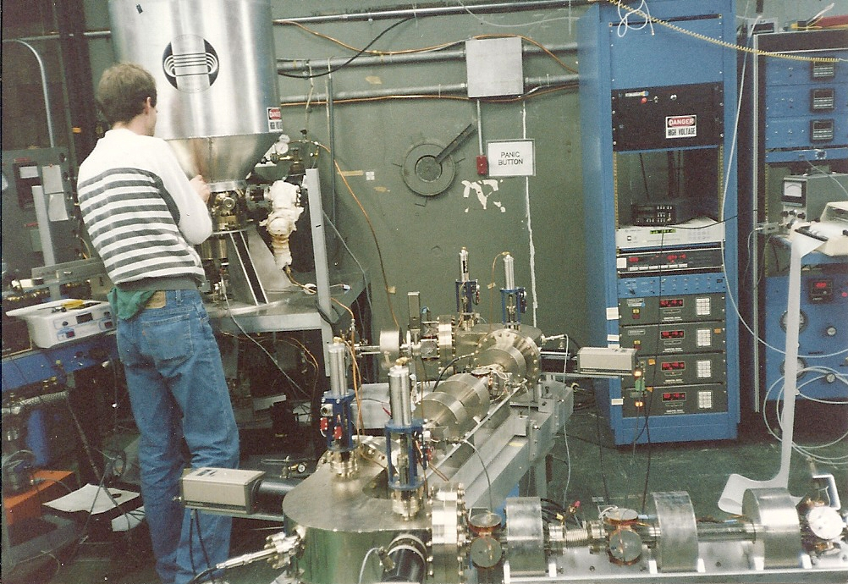
Polarized Source Tests at Illinois

Slide 7
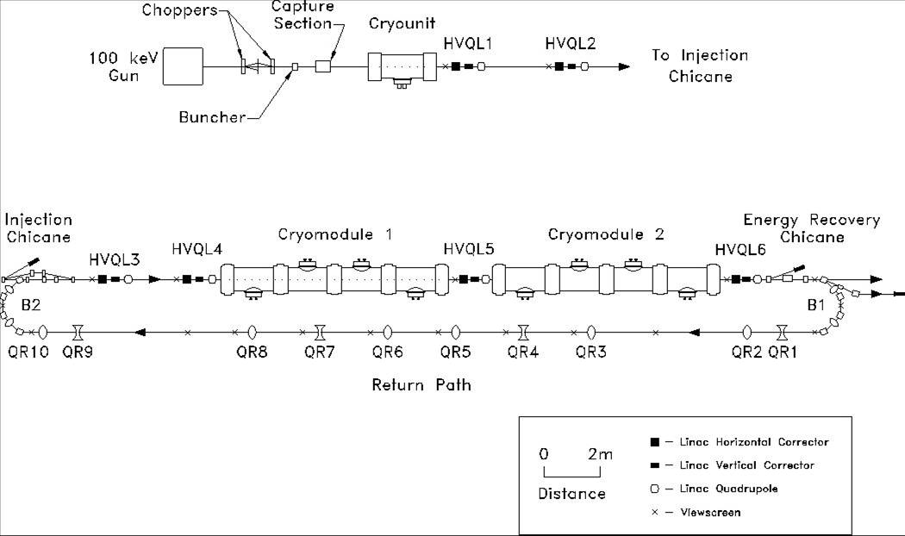
First Beam Recirculation at CEBAF

Slide 8
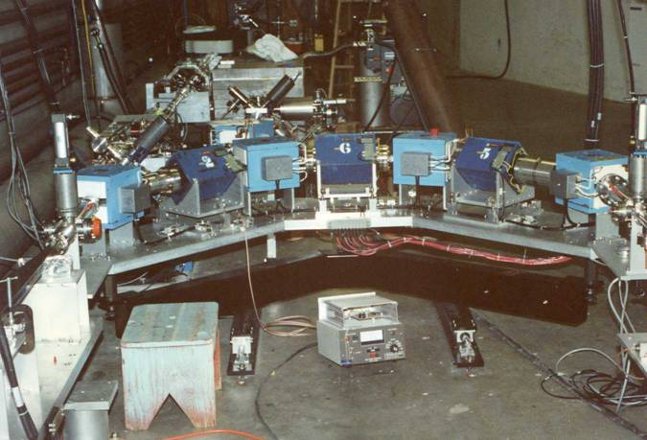
Nick’s Path Length “Trombone”

Slide 9
Recirculation Experiment
Constructed largely from Illinois microtron magnets and power supplies – and no BPMs
Showed that the full CEBAF accelerator would not fail by multi-pass beam breakup at its maximum design beam current
Demonstrated energy recovery at a then record 30 μA CW and at accelerating gradients above earlier measurements

Slide 10
Photoemission Electron Source Developments
Very high beam brightness (low emittance) from photoemission cathodes
Very high voltage DC electron guns
Long lifetime photocathodes delivering high average current, high polarization beam
Ancillary technologies – e.g. extreme high vacuum

Slide 11
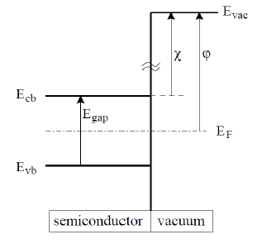
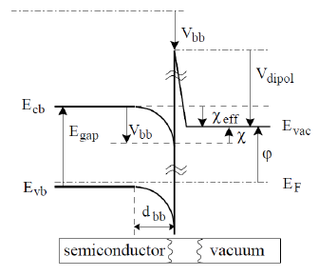
Negative Electron Affinity Photocathodes
NEA is when the bottom of the bulk conduction
band lies above the distant vacuum level – so
energetically, electrons can escape

Slide 12
First thermal emittance measurement from GaAs photocathode
The thermal, or intrinsic, emittance sets a limit on the maximum beam brightness
We initially thought our measurements showed that for wavelengths near the photoemission threshold, the intrinsic emittance corresponded to emission from a population at an effective temperature only a bit above the cathode temperature – MUCH lower than thermionic cathodes

Slide 13
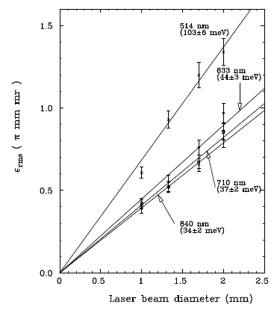
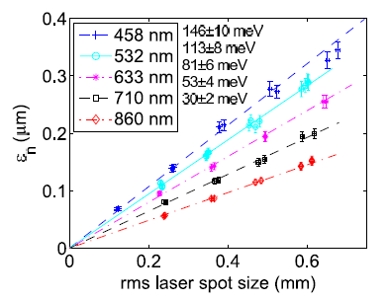
First GaAs emittance measurement
Cornell, 2007
ε_{n}=(r/2)(kT/mc²)^{1/2}
Dunham, 1993

Slide 14
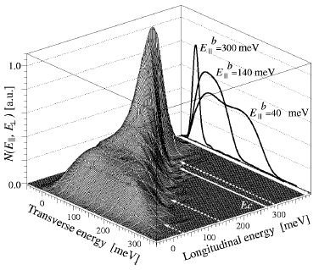
Complete Energy Distribution at 90K
From
Orlov et al.
APL 78,
2721 (2001)

Slide 15
Two very different models for intrinsic emittance
Photoemission is from a reservoir of electrons in thermal equilibrium at the cathode temperature at the conduction band minimum
Electrons in GaAs have an effective mass much smaller than the physical electron mass (0.067 m_{e}); thus when emitted they are confined to be within a relatively narrow cone (~ 15º)

Slide 16
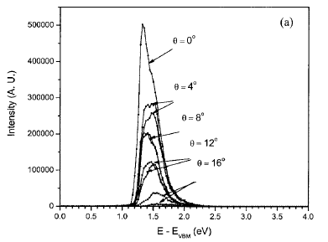
Angular Distribution Measurement
From Liu et al., JVST B 23, 2758 (2005)

Slide 17
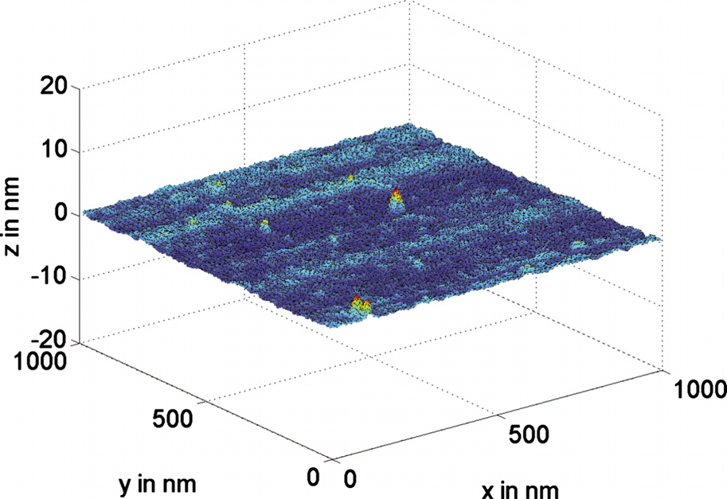
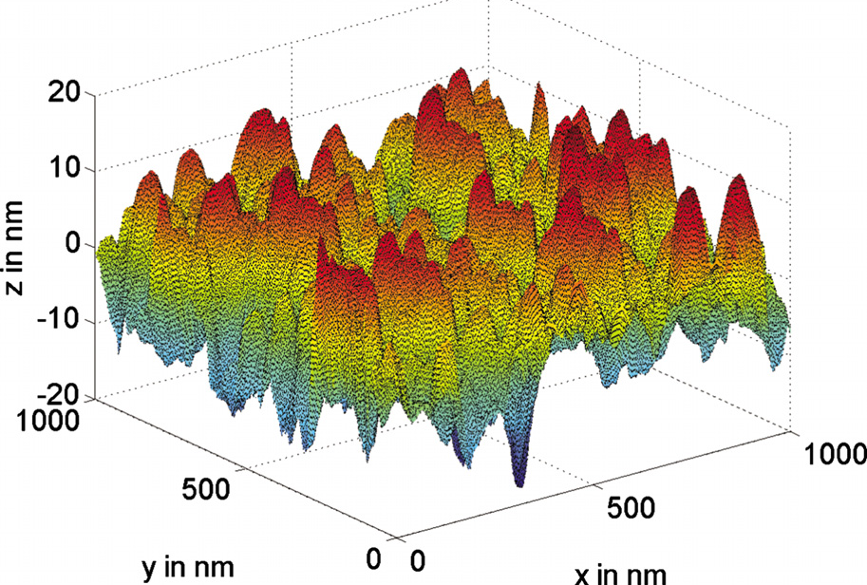
Surface Roughening may reconcile these two very different pictures
After – 6 nm rms
Before – 0.5 nm rms

Slide 18
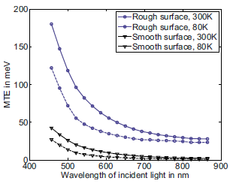
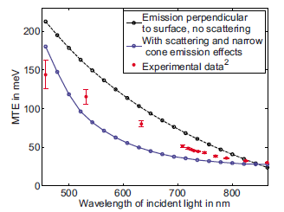
Cathodes with no roughening should make an exceptionally bright source
(Karkare and Bazarov, Appl. Phys. Lett. 98 094104 (2011))

Slide 19
Lowest full injector emittance requires temporal shaping of light
Optical pulse from
cross-correlation
Measurement
Ripple ~ 6.1%
Electron pulse from
RF deflection cavity
Measurement
Ripple ~ 4.2%

Slide 20
Does the intrinsic emittance matter?
Genetic algorithm based optimization of a real injector demonstrates that it is possible to very largely preserve the intrinsic emittance through a full injector (Bazarov and Sinclair, Phys Rev. ST-AB 8, 034702 (2005))
Demonstrated that the maximum beam brightness is determined by the ratio of the E field at the cathode to the effective transverse temperature. (Bazarov, Dunham, and Sinclair, Phys. Rev. Lett. 102, 104801 (2009))

Slide 21
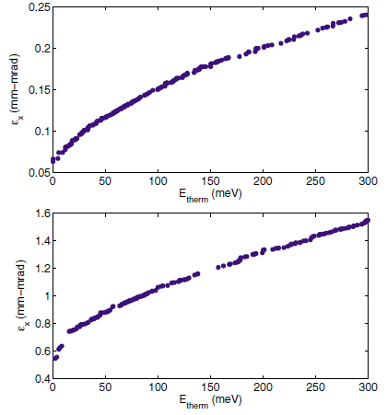
The impact of transverse energy
80 pC/bunch
800 pC/bunch

Slide 22
Application to X-ray generation
X-ray scientists desire a fully coherent beam at 1 Angstrom wavelength, allowing interference effects to be used. This requires a beam energy (and thus accelerator size and cost) given by:
≥ (4π/λ)ε_{thermal}
Assuming we can generate a beam emittance as low as calculated, this translates to a 5 GeV beam energy (the Cornell ERL design)

Slide 23
Higher Voltage Photoemission guns
Engwall built and tested a nominal 500 kV gun for his thesis – this became the first IRFEL gun, and operated at 350 kV
For the Cornell ERL, build a gun that should reach 750 kV. Presently routinely operates at 350 kV.
For the TRIUMF ARIEL project, build a gun reaching 350 kV, operating at 300 kV, with an RF modulated thermionic cathode

Slide 24
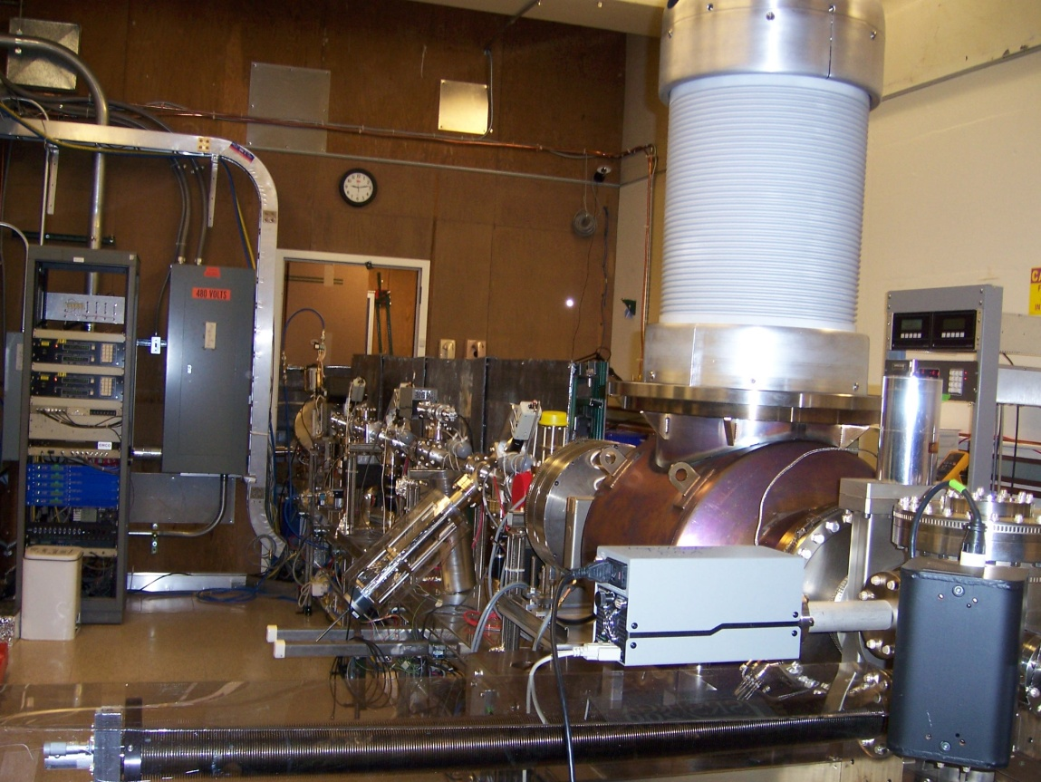
The Cornell 750 kV Gun

Slide 25
Photocathode Lifetime
The cathode dark lifetime in most guns is now very good – thousands to tens of thousands of hours
HV only, or laser illumination only, do not degrade the photocathode – degradation occurs only while running beam
Elimination of emission at large radius was a major step in improving the lifetime (JLAB)
Ion back bombardment appears to be the only significant lifetime limiting phenomenon

Slide 26
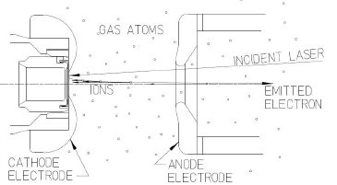
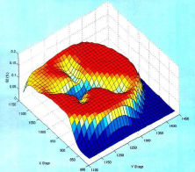
Ion Back Bombardment
Damage occurs only where ions strike – on a line joining the light incident on the cathode and the electrostatic center of the gun

Slide 27
What is the ion damage mechanism?
Removal of the Cs, F activation layer by sputtering?
Physical damage to the crystal lattice, impeding electron transport?
Electron traps or dopant modification generated by implanted ions?
The damage is NOT permanent – the cathode QE can be fully recovered
The only “cure” is improved vacuum, which is far from easy, as pressures are < 10⁻¹¹ mbar

Slide 28
Polarized Sources Today
Jlab is now operating at 170 mA, 89% polarization – for an IP² of 135 μA – a factor of 100 greater than that of the first SLAC parity experiment
Much higher currents at high polarization can be provided – Jlab tests have delivered several mA – enough to think about making polarized positrons!
Cathode lifetime remains the principal issue for all present accelerators

Slide 29
35 years after the first GaAs polarized source, some mysteries remain……..
Nitrogen activation
Copper
Short operating life – vacuum or what?
A source delivering 100 mA or more will likely require a different cathode – chalcopyrites, as we studied so long ago at Illinois?

Slide 30
The program Larry initiated so long ago at Illinois has borne great fruit for Jefferson Lab’s science - - -
THANK YOU, LARRY

